Slide 1
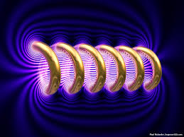


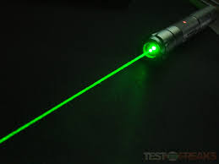


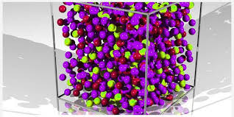
Engineering Physics
PHY-109
Waves-5
ELECTROMAGNETIC THEORY
QUANTUM MECHANICS
LASER
WAVES
Dr. Jeeban Pd Gewali
Department of Physics
Lovely Professional University
Phagwara, Punjab-144411
SOLID STATE PHYSICS
FIBER OPTICS

Slide 2
Syllabus
Interference phenomenon and Concept of resonance
Audible, ultrasonic and infrasonic waves. Production of ultrasonic waves by magnetostriction method.
Ultrasonic transducers and their uses, applications of ultrasonic waves, detection of ultrasonic waves (Kundt's tube method, sensitive flame method and piezoelectric detectors),
Absorption and Dispersion of ultrasonic waves.
Superposition of two waves, sound wave and its velocity, standing waves, Formation of beats, Supersonic and shock waves.

Slide 3
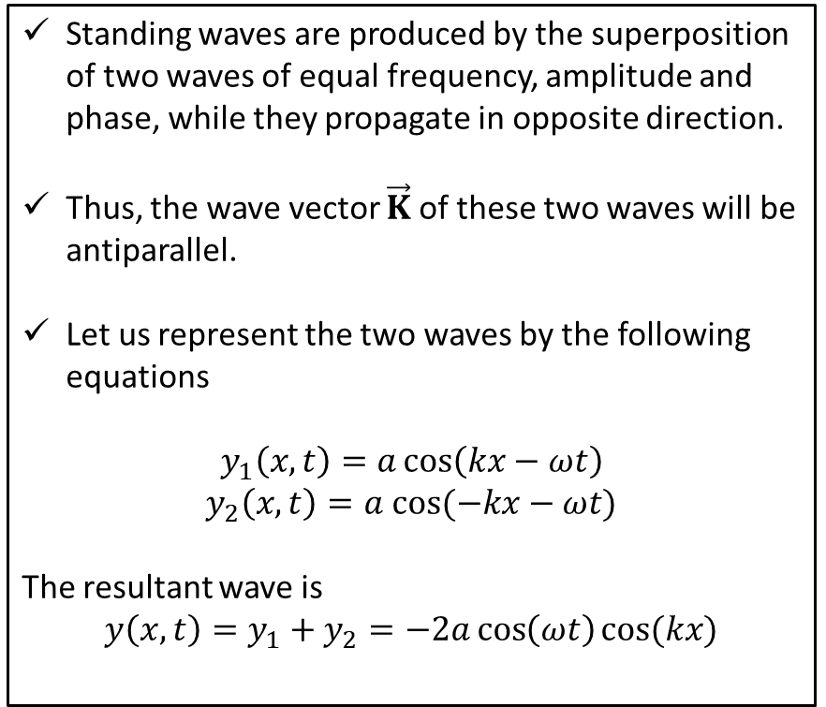
Standing waves
The plot shows the formation of standing waves at different instances of time.
Standing waves are produced by the superposition of two waves of equal frequency, amplitude and phase, while they propagate in opposite direction.
Thus, the wave vector $\vec{K}$ of these two waves will be antiparallel.
Let us represent the two waves by the following equations
$$y_{1}\left(x,t\right)=a\cos\left(kx−ωt\right)$$
$$y_{2}\left(x,t\right)=a cos⁡(−kx−ωt)$$
The resultant wave is
$$y\left(x,t\right)=y_{1}+y_{2}=−2a\cos\left(ωt\right)cos⁡(kx)$$
Minimum or node
Maximum or antinode
Here, it is seen that the minima and the maxima are fixed in space, unlike other propagating or travelling waves. The minimum are known as nodes and the maximums are known as antinode.

Slide 4
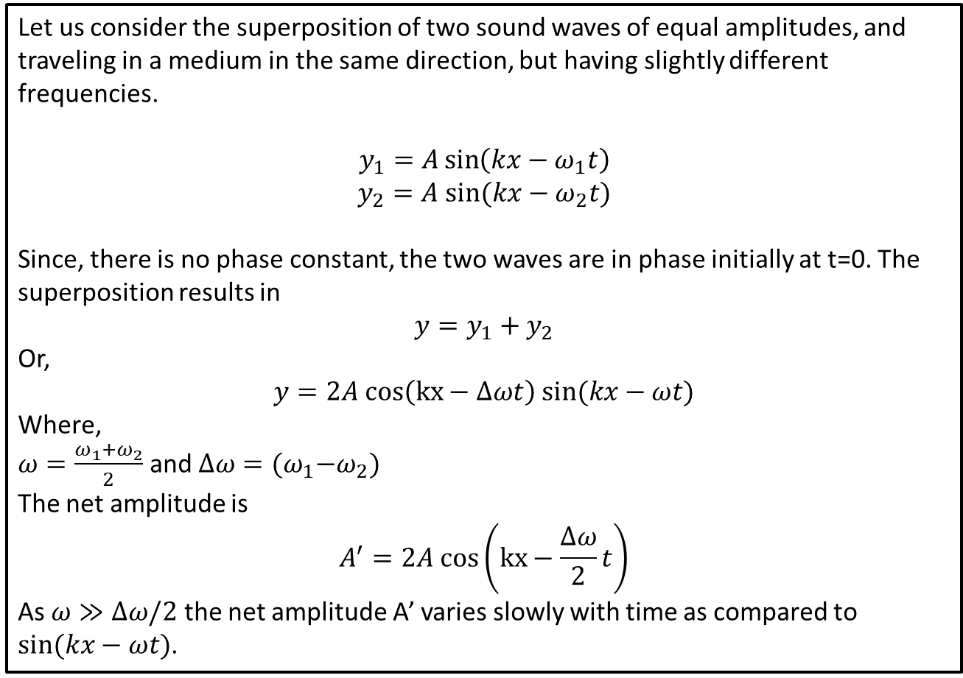
Formation of Beats
Let us consider the superposition of two sound waves of equal amplitudes, and traveling in a medium in the same direction, but having slightly different frequencies.
$$y_{1}=A\sin\left(kx−ω_{1}t\right)$$
$$y_{2}=A sin⁡(kx−ω_{2}t)$$
Since, there is no phase constant, the two waves are in phase initially at t=0. The superposition results in
$$y=y_{1}+y_{2}$$
Or,
$$y=2A cos\left(kx−Δωt\right) sin⁡(kx−ωt)$$
Where,
$ω=\frac{ω_{1}+ω_{2}}{2}$ and $Δω={(ω}_{1}−ω_{2})$
The net amplitude is
$$A^{′}=2A cos\left(kx−\frac{Δω}{2}t\right)$$
As $ω≫Δω/2$ the net amplitude A’ varies slowly with time as compared to $sin⁡(kx−ωt)$.

Slide 5
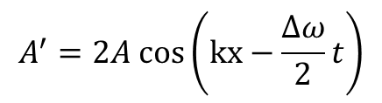
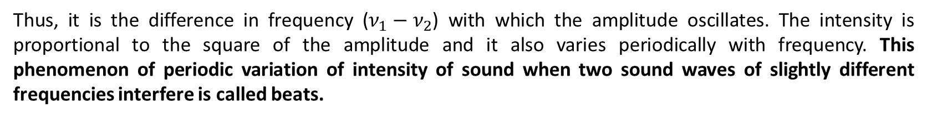
Formation of Beats
$$A^{′}=2A cos\left(kx−\frac{Δω}{2}t\right)$$
Net Amplitude
Thus, A’ varies with an angular frequency $Δω/2$. The frequency varies as $2πν=\frac{Δω}{2}$ or, $ν=\frac{Δω}{4π}\sim (ν_{1}−ν_{2})$
Thus, it is the difference in frequency ($ν_{1}−ν_{2}$) with which the amplitude oscillates. The intensity is proportional to the square of the amplitude and it also varies periodically with frequency. This phenomenon of periodic variation of intensity of sound when two sound waves of slightly different frequencies interfere is called beats.
Specifically, one cycle of maximum intensity and minimum intensity is counted as one beat.

